Slide 1

An Najah Rank
Software Graduation Project

Slide 2
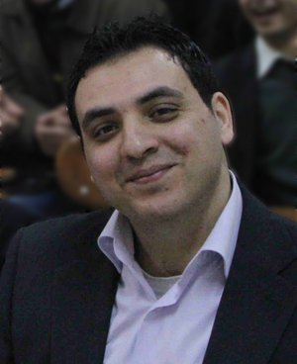
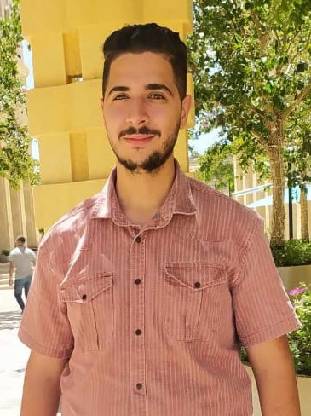
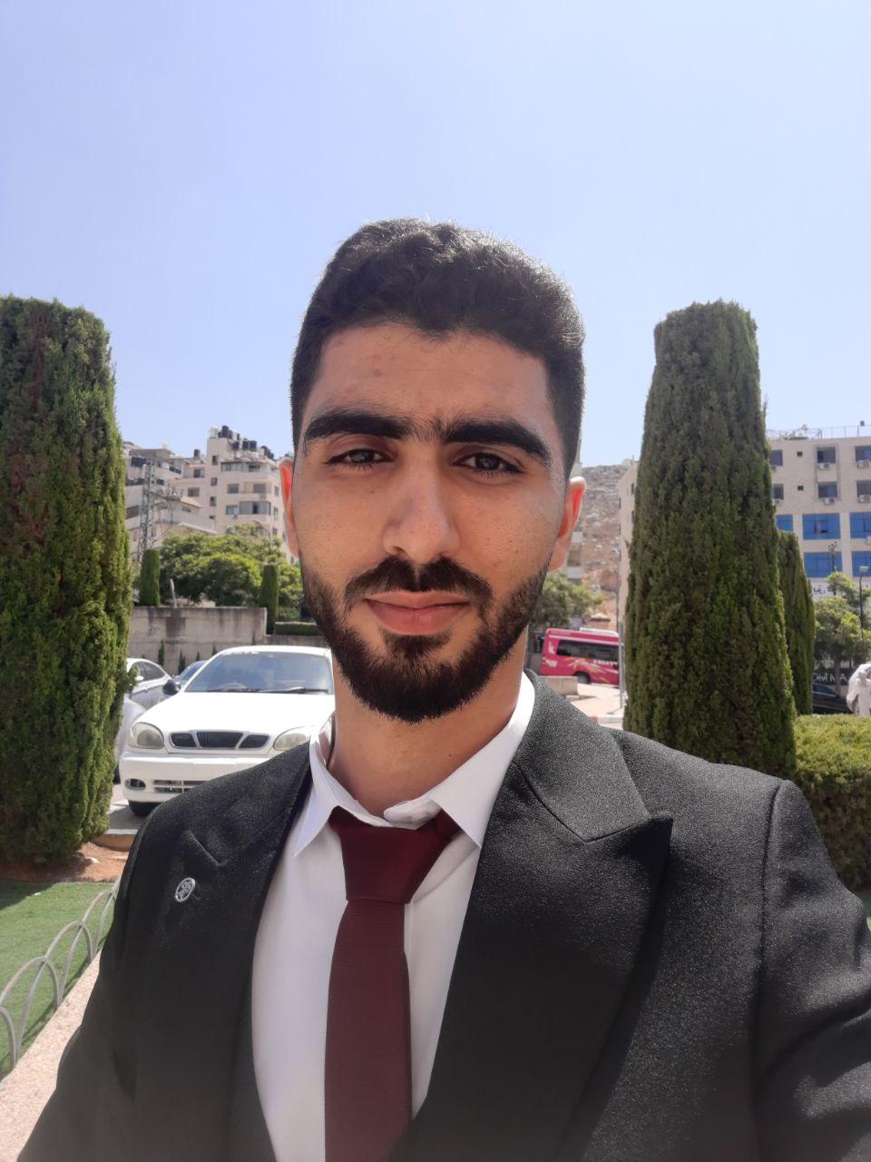
Our Team
Supervisor
Dr. Samer Arandi
Momen Odeh
Noor Aldeen
Abu Shehadeh

Slide 3
Table of contents
01
Problem Statment
02
Our Solution
03
Project Implementation
04
Project Components
05
Challenges and Constraints
06
Future Work

Slide 4

What ‘s the problem?
The problem-solving skills are one of the most important skills in the workplace.
An-Najah National University strives to improve these skills in our students by incorporating problem-solving tasks into many courses using external problem-solving websites.
However, these websites lack essential features that would simplify the problem-solving process and make solution grading more efficient.

Slide 5
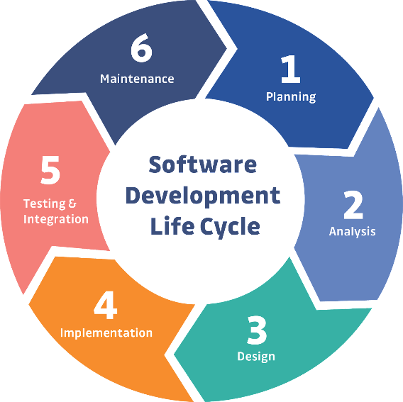
Project Implementation
Software Development Life Cycle:

Slide 6
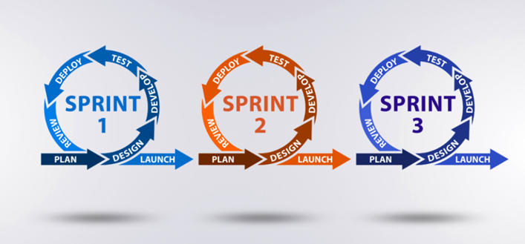
Project Implementation (cont.)
Agile Methodology:

Slide 7

Planning Phase
We met with our client Dr. Samer Arandi.
We explored various problem-solving websites.
explored new functionalities to enhance the project.

Slide 8

Analysis Phase
Gathering and Documenting Requirements through stakeholder engagement and user feedback sessions.
Crafting user stories to clearly outline specific functionalities.
Envisioning the system's architecture using Unified Modeling Language (UML) diagrams.

Slide 9
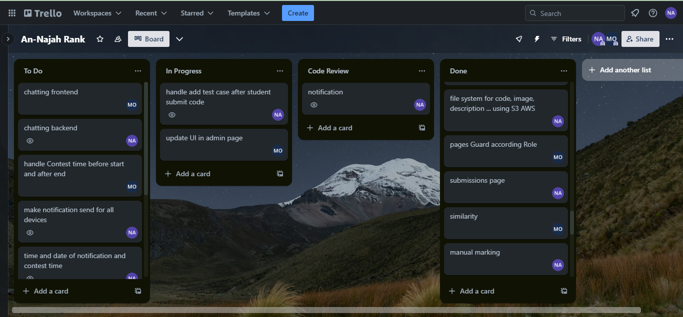
Analysis Phase (cont.)
User Stories:

Slide 10
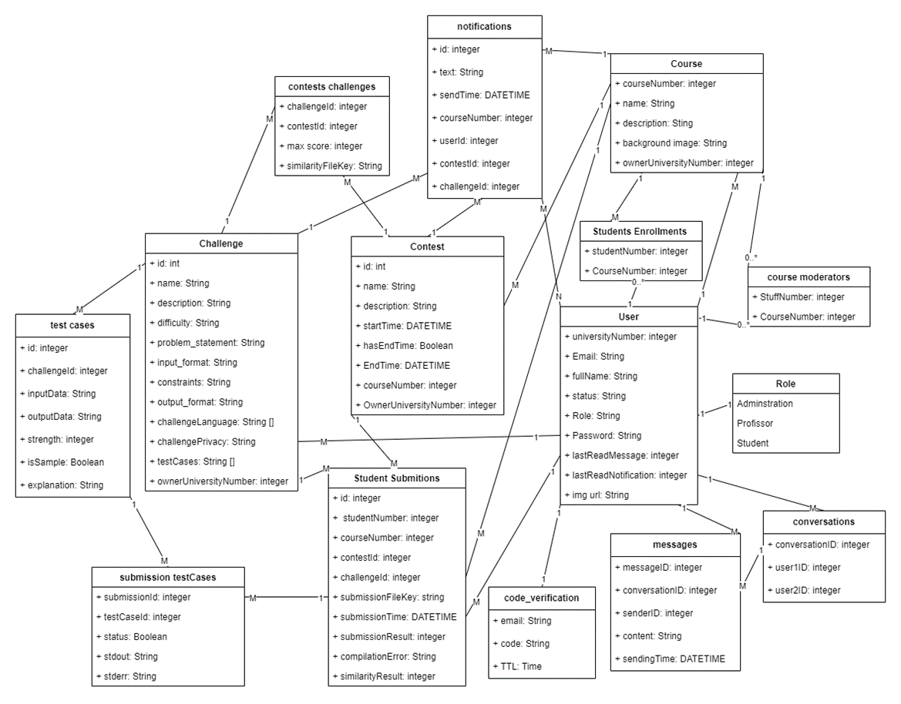
Analysis Phase (cont.)
UML Diagram:

Slide 11
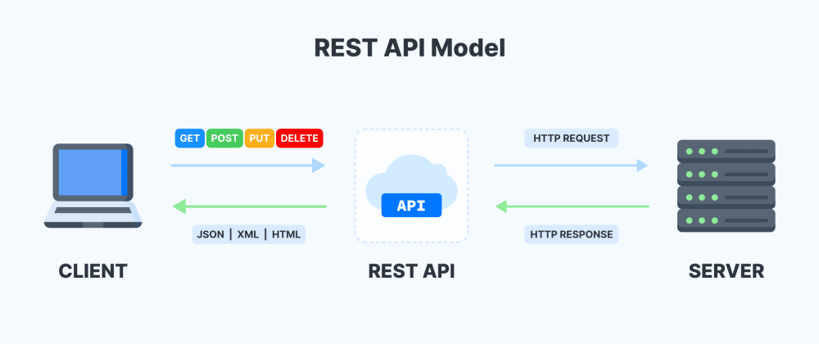
Design Phase
Architectural Style:

Slide 12
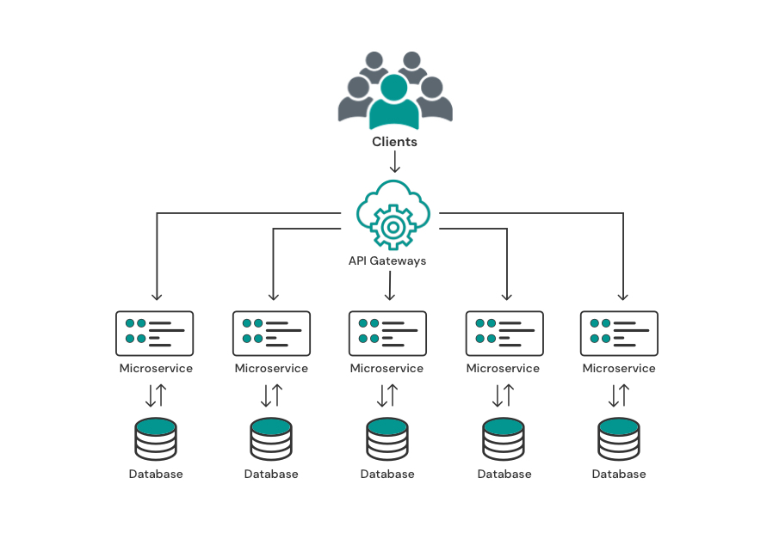
Design Phase (cont.)
Architectural Pattern:
Microservice Architectural pattern

Slide 13







Design Phase (cont.)
Frontend tools:
Backend tools:

Slide 14







Design Phase (cont.)
DevOps tools:
AWS Cloud Formation:

Slide 15





Design Phase (cont.)
Development tools:

Slide 16
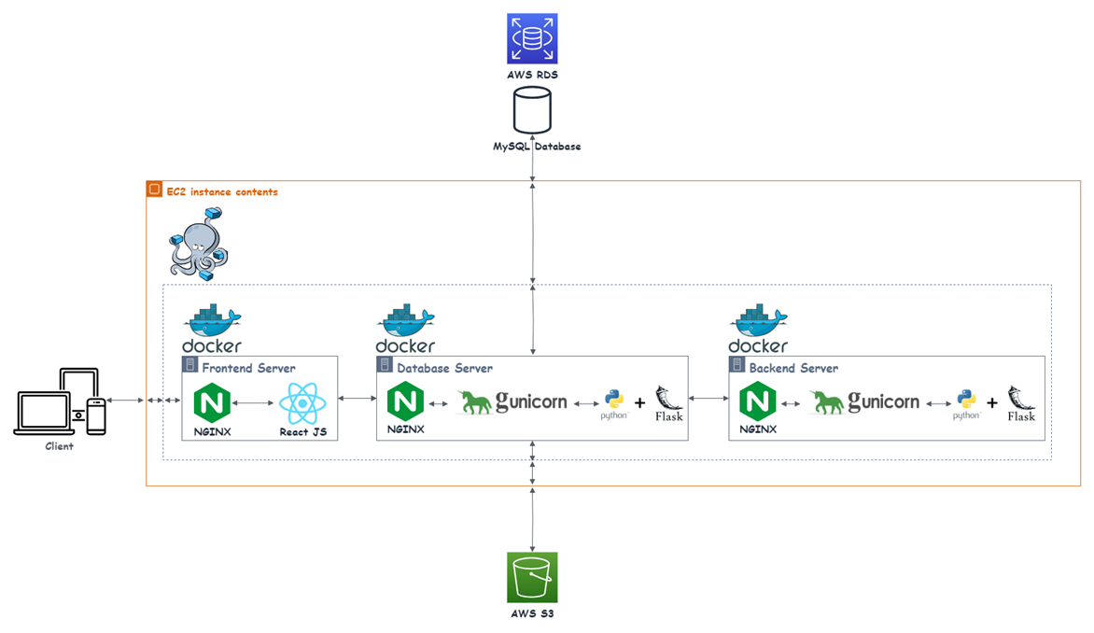
Design Phase (cont.)
Project Structure:

Slide 17




Security
Authentication: verifying a user or device before allowing access to web application.
Authorization: giving the user permission to access a specific page.
CORS policies: a mechanism that allows restricted resources on a web page to be accessed from another domain outside the domain from which the first resource
Library used:

Slide 18
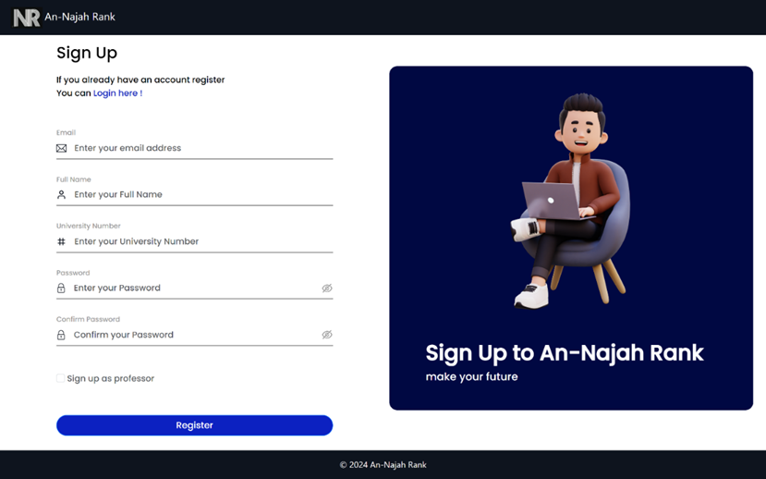
User Features
Registration:

Slide 19

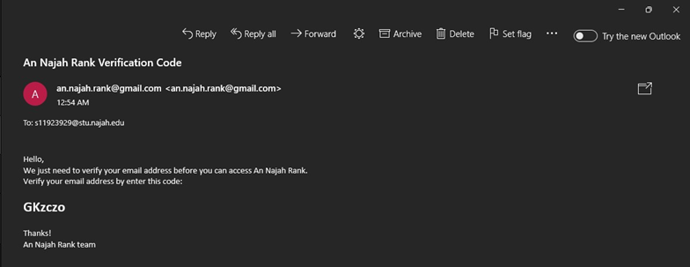
User Features
verification code:

Slide 20
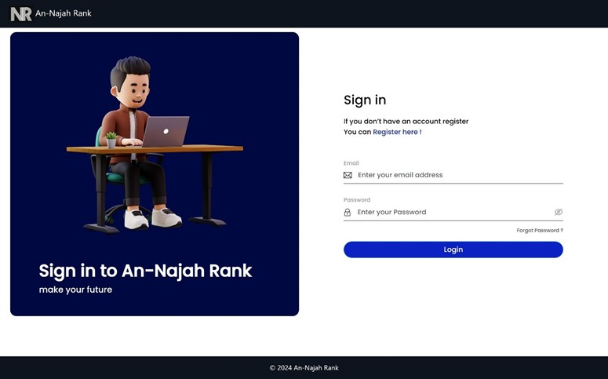
User Features
Sign in:

Slide 21
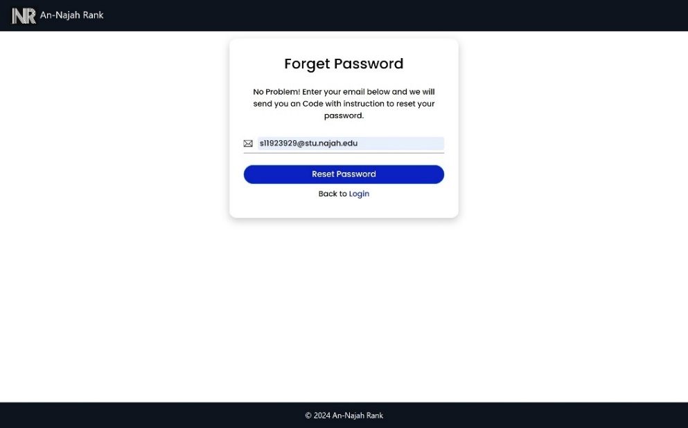
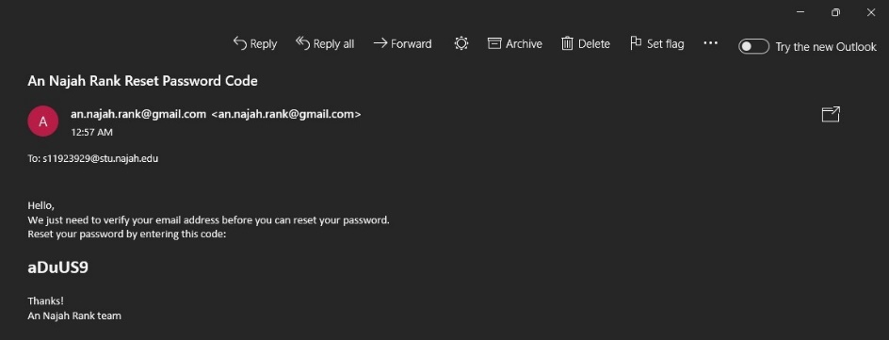
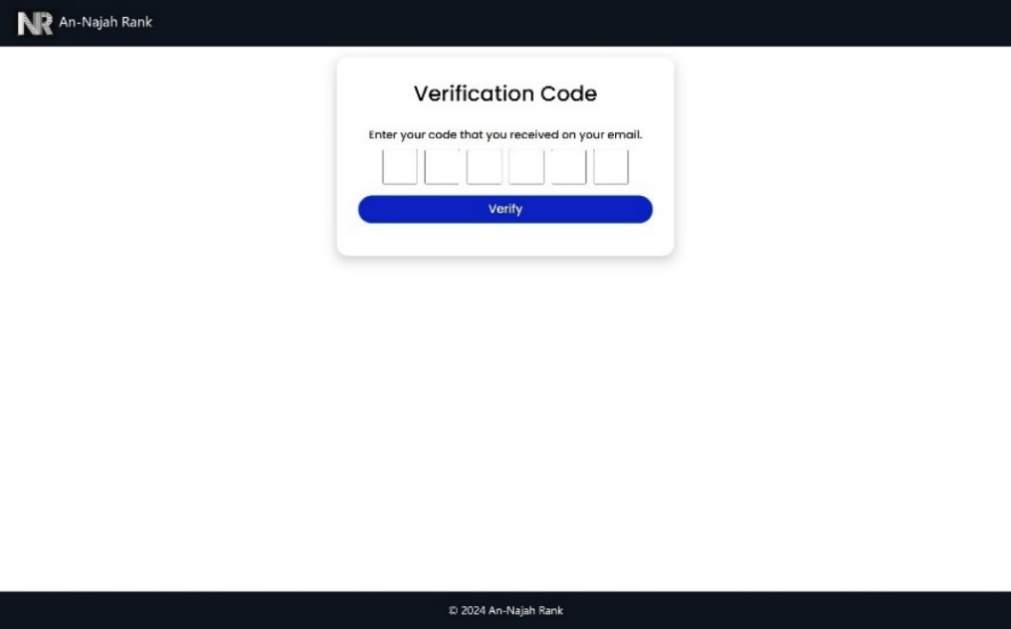
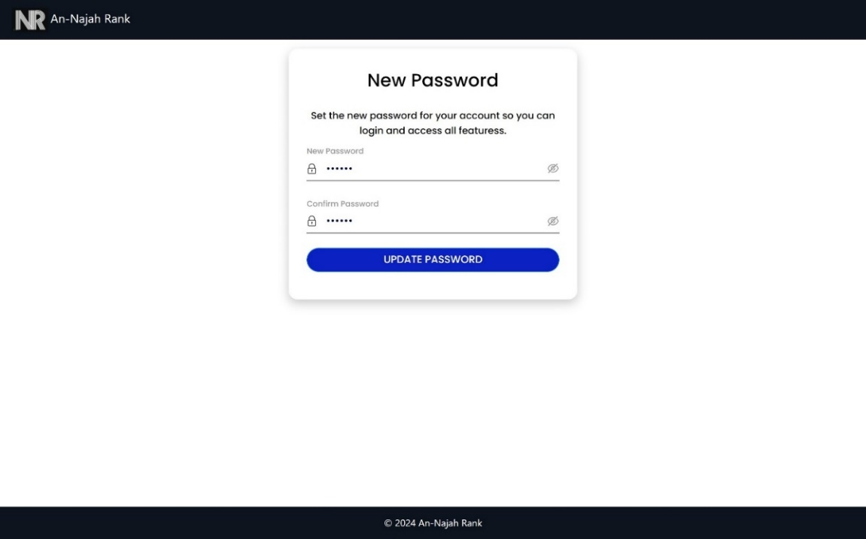
User Features
Forget password:

Slide 22
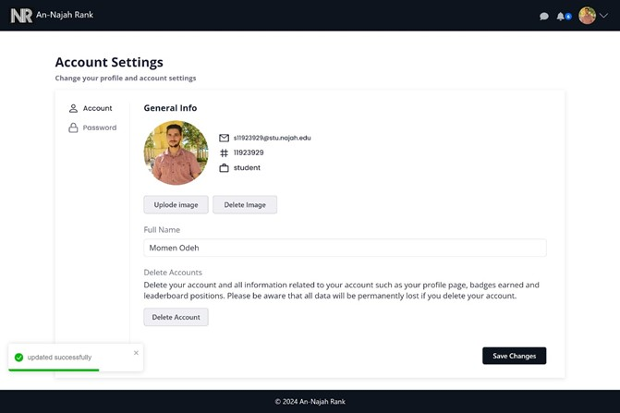
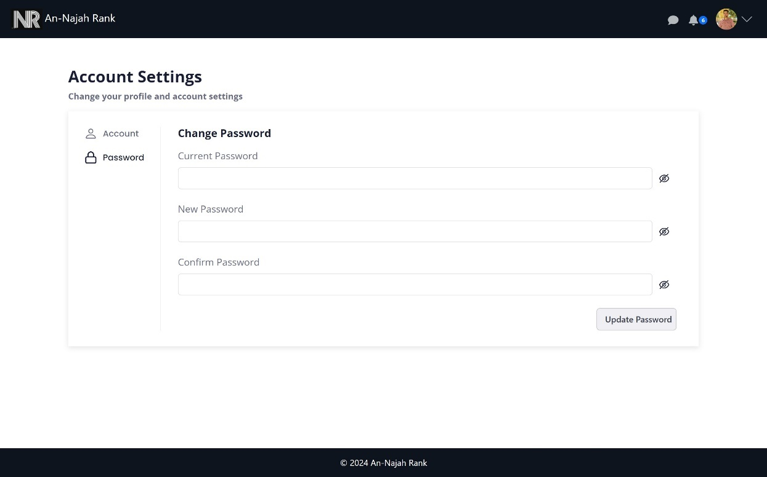
User Features
Account Settings:

Slide 23
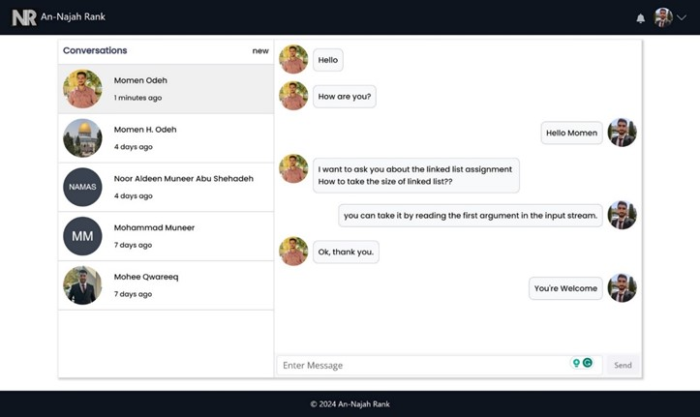
User Features
Chatting:

Slide 24
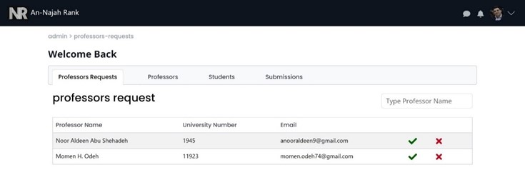
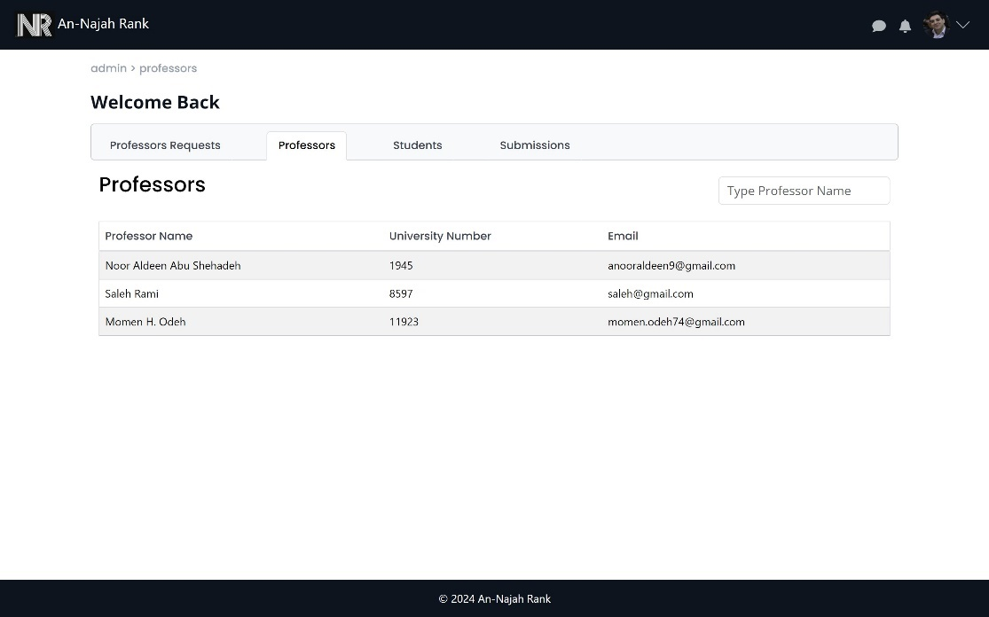
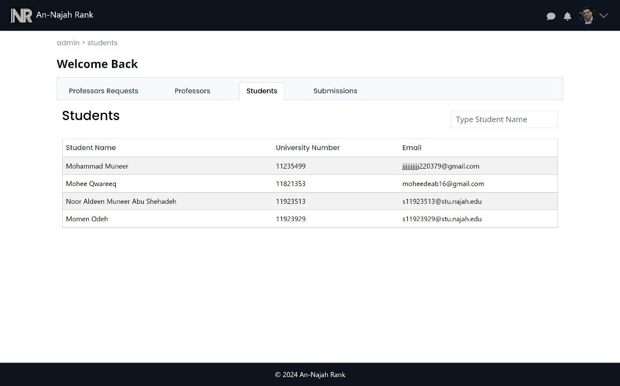
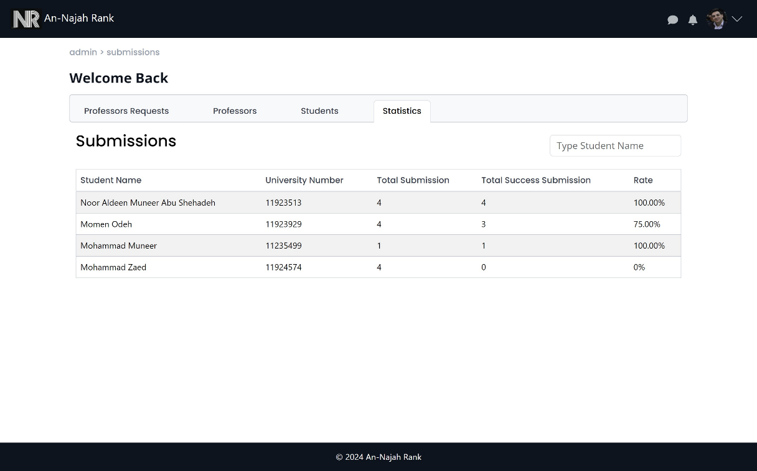
Admin Features
pending professors
all professors in the system
all students in the system
Students statistics

Slide 25
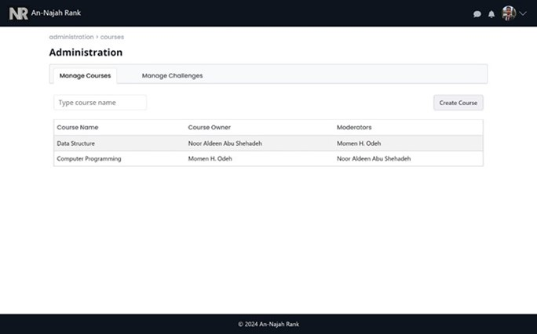
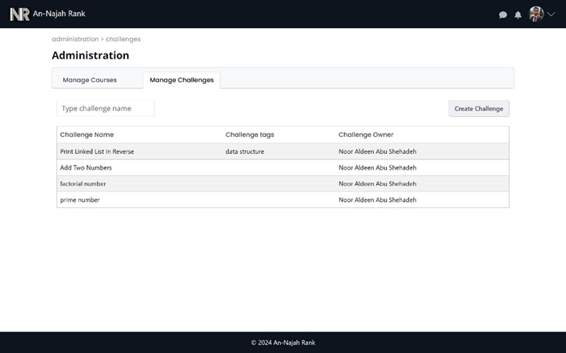
Professor Features
Registration:
Mange Courses
Mange Challenges

Slide 26
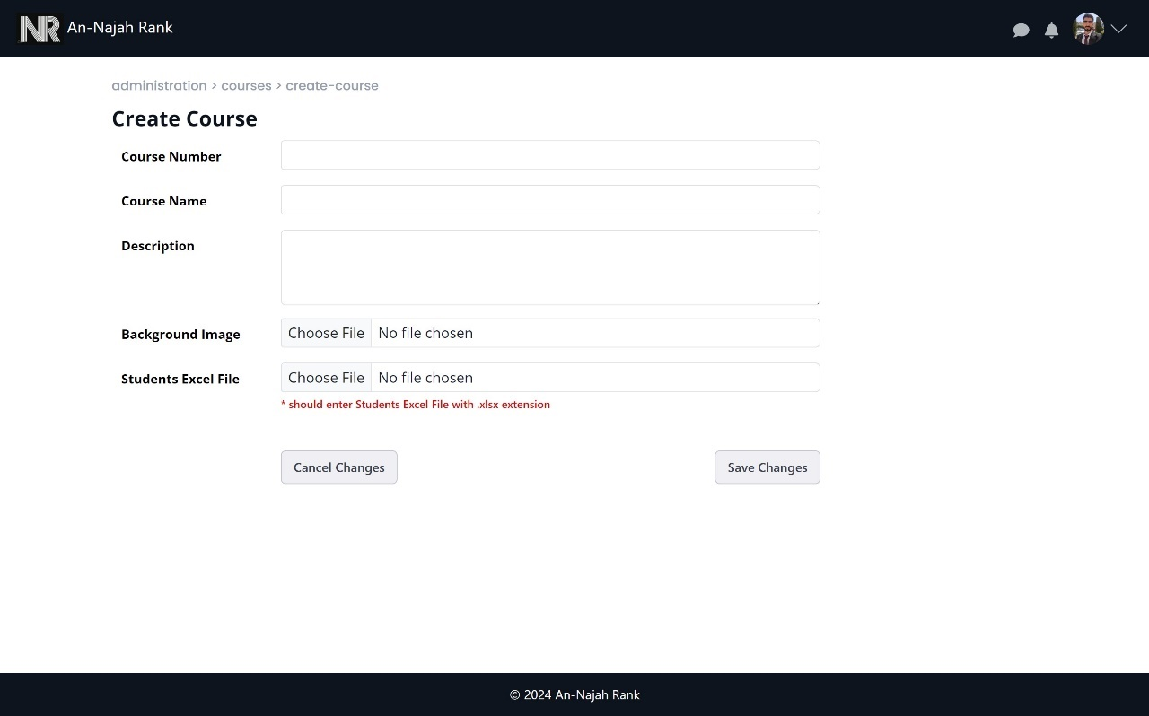
Professor Features
Create course:

Slide 27
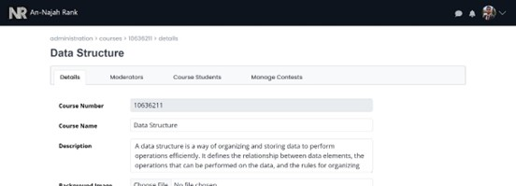
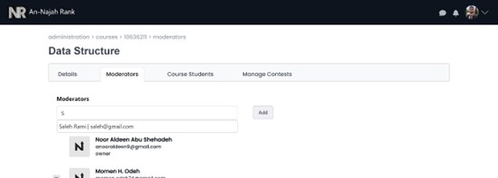
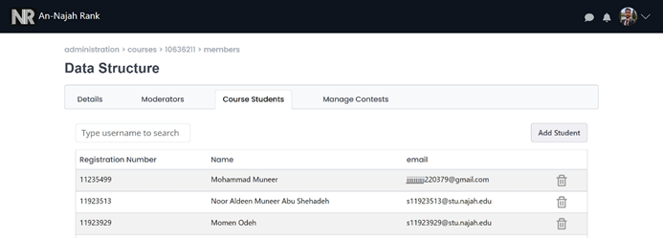
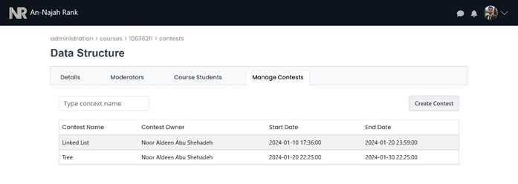
Professor Features
Manage course details
Manage course moderators
Manage students in course
Manage contests

Slide 28
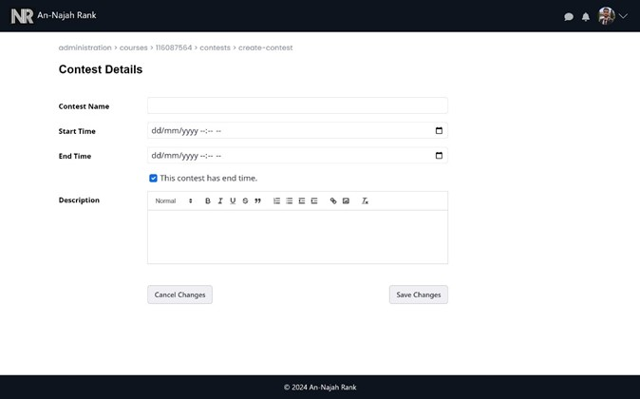
Professor Features
Create contest:

Slide 29
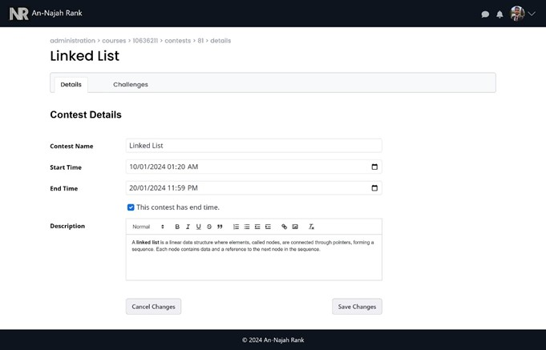
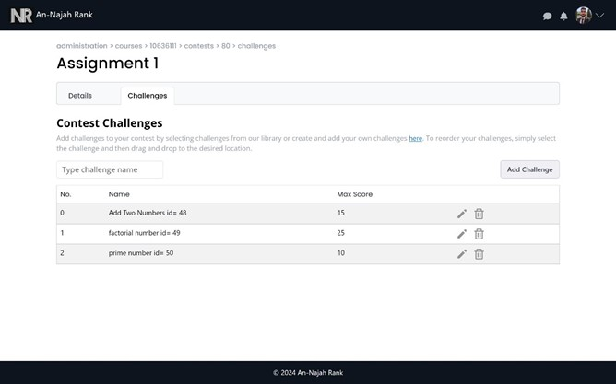
Professor Features
Manage contest details
Manage challenges in contest

Slide 30
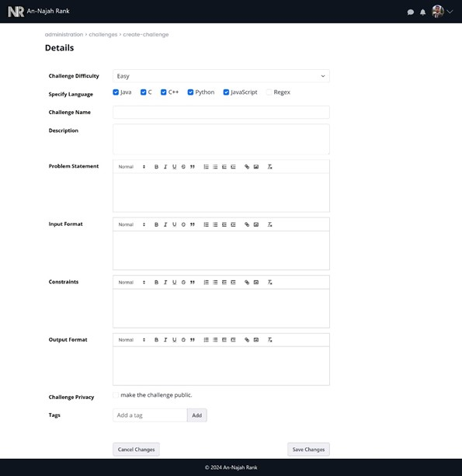
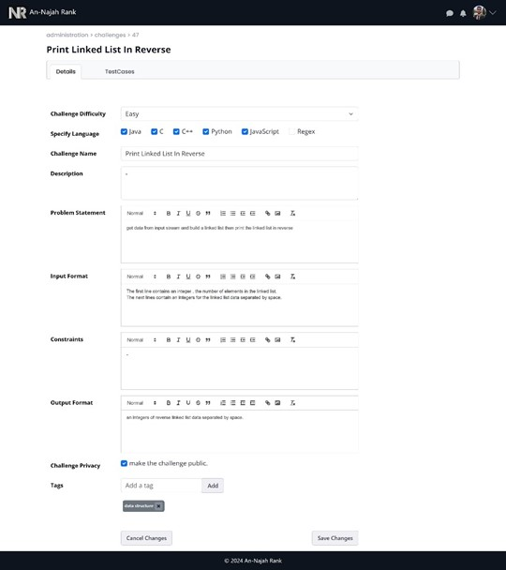
Professor Features
Create challenge
Manage challenge details

Slide 31
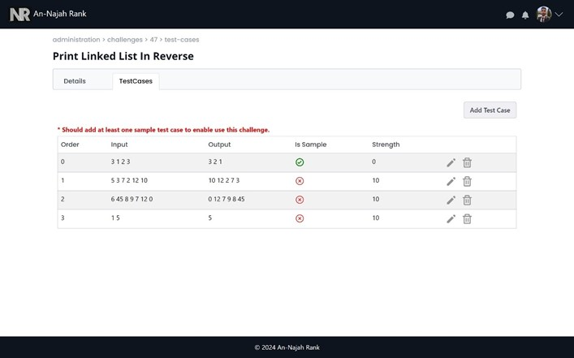
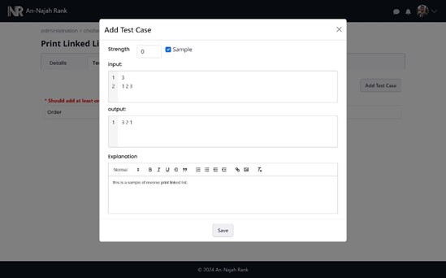
Professor Features
Manage test cases in challenge
Add test case to challenge

Slide 32
User Features
Registration:

Slide 33
User Features
Registration:

